Slide 1
Building a Trauma-Informed Tribal Nation
Teresa Brockie, RN, PhD
Research Nurse Specialist
National Institutes of Health Clinical Center
Nursing Department
brockiet@cc.nih.gov
Federal Partners Committee on Women and Trauma 2015 National Event: Building a Trauma-Informed Nation: Moving the Conversation into Action
September 29-30, 2015 U.S. Department of Labor
Notes:
I am

Slide 2
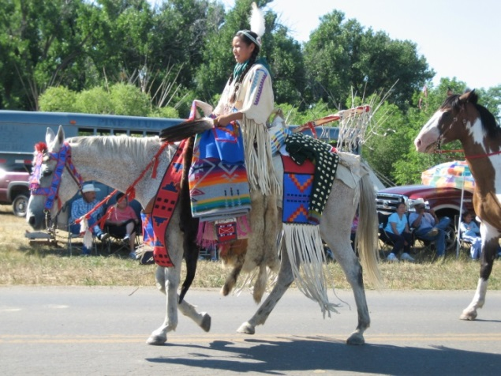
An Indigenous Researcher
White Clay Nation
Fort Belknap Indian Reservation
BSN-Public Health Nurse
University of North Dakota
MSN Community Health
Johns Hopkins University
PhD Nursing
Johns Hopkins University
3rd my tribe to achieve PhD
~25 Native American
Nurses with PhD
Notes:
Text Description of Images:
The shield of the Fort Belknap Indian Reservation represents the protection of the White Clay and Nakoda from the past, present and future.
The meadowlark is a song-bird of the plains and is my tribal name, Ibigeewatsi
The second picture represents the richness of my culture.

Slide 3
Current work

Slide 4
Historical and Contemporary Factors Influencing the Lives of Reservation-based Native American Youth: Non-Lethal Suicidal Behavior
Reservation within county listed among 100 poorest and 10 least healthy in the US
In 2010, after 6 suicides and 20 attempts in 5 months, tribal leadership declared state of emergency
In 2011, collected data from youth ages 15-24 years of age (N=288) from two tribes on one reservation in the northern plains
U.S. Census Bureau. Small Area Income and Poverty Estimates. 2010; http://www.census.gov/did/www/saipe/methods/statecounty/2010county.html.
University of Wisconsin Population Health Institute. County Health Rankings & Roadmaps: A Healthier Nation, County by County. 2010; www.countyhealthrankings.org.
Brockie TN, Dana-Sacco G, Wallen GR, Wilcox HC, Campbell JC. The Relationship of Adverse Childhood Experiences to
PTSD, Depression, Poly-Drug Use and Suicide Attempt in Reservation-Based Native American Adolescents and Young Adults.
American Journal of Community Psychology. Apr 2015; 55(3-4).

Slide 5
Important Findings
Historical Trauma (22%)
More perceived great/grandparents boarding school experience as positive than negative
Historical Trauma (HT) operationalized as family history of negative boarding school experience
No evidence that HT potentiates more severe response to current traumatic events
Brockie TN, Dana-Sacco G, Wallen GR, Wilcox HC, Campbell JC. The Relationship of Adverse Childhood Experiences to
PTSD, Depression, Poly-Drug Use and Suicide Attempt in Reservation-Based Native American Adolescents and Young Adults.
American Journal of Community Psychology. Apr 2015; 55(3-4).

Slide 6
Important Findings
Suicide Ideation (45%)
Increased risk for:
Youth ages 15-19 years (AOR=4.8) compared to ages 19-24
Poly-drug users (AOR=3.6)
Suicide Attempts (35%)
Increased risk for:
HT (AOR=4.3)
Poly-drug users (AOR=2.3)
PTSD symptoms (AOR=2.6)
Depression symptoms (AOR=3.6)
Brockie TN, Dana-Sacco G, Wallen GR, Wilcox HC, Campbell JC. The Relationship of Adverse Childhood Experiences to
PTSD, Depression, Poly-Drug Use and Suicide Attempt in Reservation-Based Native American Adolescents and Young Adults.
American Journal of Community Psychology. Apr 2015; 55(3-4).

Slide 7
Important Findings
Adverse Childhood Experiences (96%)
8 ACEs:
emotional, physical, and sexual abuse
physical and emotional neglect
witness to violence directed at mother
historical loss associated symptoms
perceived discrimination
Each additional ACE increased odds of:
suicide attempts (36%)
poly-drug use (73%)
PTSD symptoms (60%)
depression symptoms (30%)
Brockie TN, Dana-Sacco G, Wallen GR, Wilcox HC, Campbell JC. The Relationship of Adverse Childhood Experiences to
PTSD, Depression, Poly-Drug Use and Suicide Attempt in Reservation-Based Native American Adolescents and Young Adults.
American Journal of Community Psychology. Apr 2015; 55(3-4).

Slide 8
TRIBAL DATA DISSEMINATION

Slide 9
Community-based Symposium
Day 1: Knowledge – Health Impacts of Trauma and Prevention Approaches
Day 2: Context – Tribal History and Treatment Approaches
Day 3: Application – Development of a Trauma-Informed Community Strategy
Notes:
The save the date flyer for the community based Fort Peck Health and Resilience Symposium: Creating a Trauma-Informed Tribal Community

Slide 10
Putting Our Minds Together
Tribal Collaboration
5th year
Tribal Advisory Board
Community-based Participatory Research (CBPR)
Address trauma and ACEs with early intervention among parent-child dyads in Head Start
Trauma Focused-Cognitive Behavior Therapy (TF-CBT)
Adapted, pilot tested, and implemented in LMIC with vulnerable children.
Found to reduce negative emotional outcomes and improve health outcomes
Murray LK, Skavenski S, Michalopoulos LM, et al. Counselor and client perspectives of Trauma-focused Cognitive Behavioral Therapy for
children in Zambia: a qualitative study. Journal of clinical child and adolescent psychology : the official journal for the Society of Clinical Child
and Adolescent Psychology, American Psychological Association, Division 53. 2014;43(6):902-914.

Slide 11
Needs
Identify and assess effective models
Measure effect of trauma-informed care on health outcomes and costs
Resources to support ongoing efforts, such as technical assistance to tribal communities
Menominee Nation as model
Comprehensive trauma informed initiative
Uses “Bridges out of Poverty“ Framework

Slide 12
Roundtable on Trauma-Informed Initiatives in
Native American Communities
Developed after roundtable on trauma in Native American communities sponsored by Senator Heidi Heitkamp (D-ND)
Small group of professionals
Aim to encourage tribes, Federal agencies, and Congress to develop a trauma-informed agenda
Available to support effort to create a national initiative to address trauma in Indian Country

Slide 13
Call to Action for Federal Partners
Paradigm shift is required to address the trauma-related issues in Indian Country
Identify best strategies to engage community stakeholders, informal and formal community members, spiritual leaders, etc.
Develop an Interagency Taskforce for Indian Country to develop a set of guidelines to direct the nation
Need healthcare workforce that understands long-term implications of trauma and is well-prepared to provide effective trauma-care

Slide 14
Works Cited
U.S. Census Bureau. Small Area Income and Poverty Estimates. 2010; http://www.census.gov/did/www/saipe/methods/statecounty/2010county.html.
University of Wisconsin Population Health Institute. County Health Rankings & Roadmaps: A Healthier Nation, County by County. 2010; www.countyhealthrankings.org.
Brockie TN, Dana-Sacco G, Wallen GR, Wilcox HC, Campbell JC. The Relationship of Adverse Childhood Experiences to PTSD, Depression, Poly-Drug Use and Suicide Attempt in Reservation-Based Native American Adolescents and Young Adults. American journal of community psychology. Jun 2015;55(3-4):411-421.
Murray LK, Skavenski S, Michalopoulos LM, et al. Counselor and client perspectives of Trauma-focused Cognitive Behavioral Therapy for children in Zambia: a qualitative study. Journal of clinical child and adolescent psychology : the official journal for the Society of Clinical Child and Adolescent Psychology, American Psychological Association, Division 53. 2014;43(6):902-914.

Slide 15
Let us put our minds together and see what life we can make for our children.
Notes:
An image of Hunkpapa Lakota Chief Sitting Bull

Slide 16
GinnyHayats
Teresa N. Brockie, RN, PhD
Research Nurse Specialist
National Institutes of Health Clinical Center
brockiet@cc.nih.gov

